Slide 1
DSE5300 – Week 3 Lecture
Understanding disclosure risks
September 14, 2021
Fotios Kokkotos, PhD
kokkotosf@merrimack.edu

Slide 2
Scope, Terminology and Definitions
The probability of re-identification will be framed from what a custodian is expected to know and do
When the original dataset is transformed into a de-identified dataset it becomes a de-identified file (DF)
DF maybe a sample of records in the original dataset or it may include all the records in the original dataset.
During the process of creating a DF, intermediate DFs will be created and evaluated. We refer to these as “candidate DFs” to distinguish them from the final DFs that are actually used or disclosed.

Slide 3
Unit of Analysis and Data Types
In this course, the unit of analysis will be an individual: data subject
We will focus on single level relational data
This is the most common type of data and consists of a fixed number of variables and a fixed number of rows
All records have the same number of fields. Each record pertains to a single individual, and an individual would appear only once in the original dataset

Slide 4
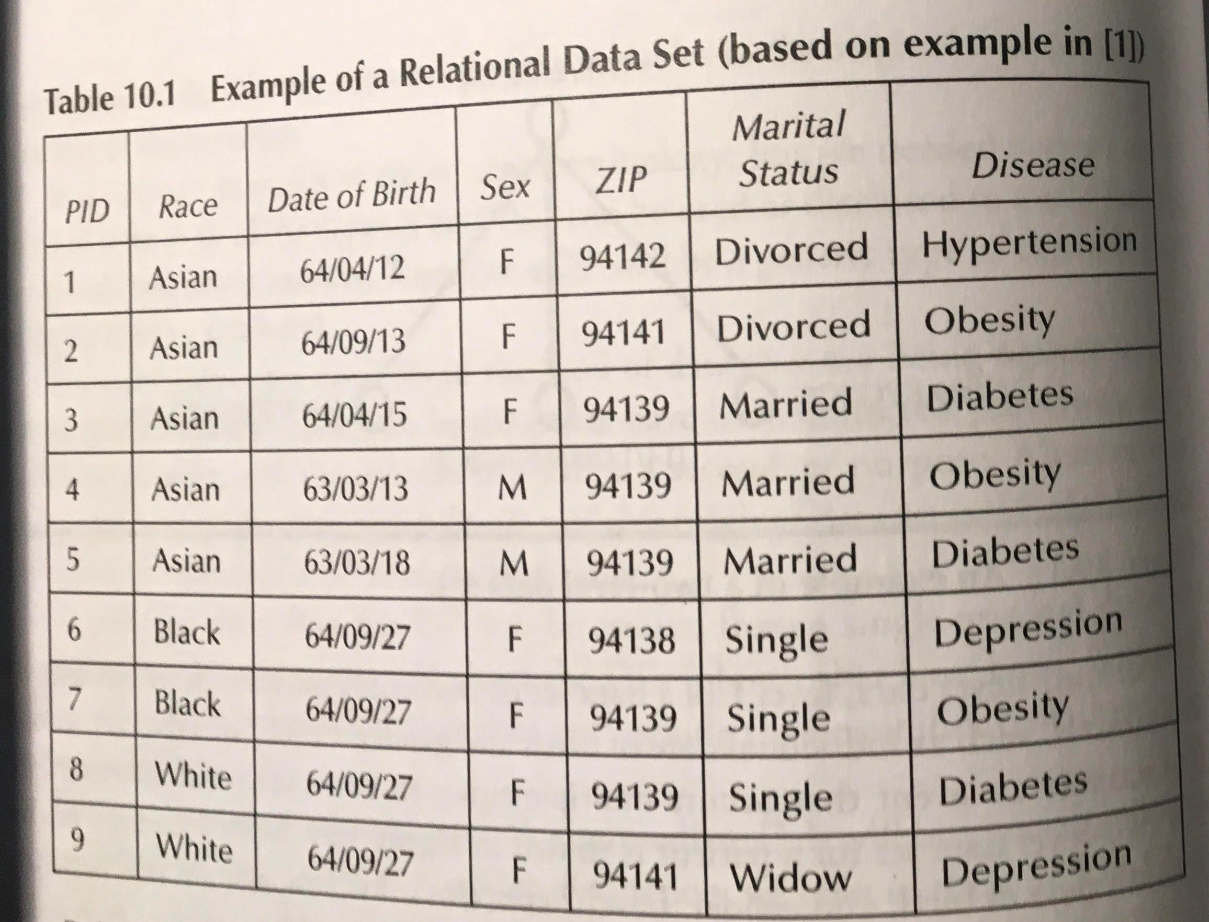
Example of a Relational Data Set

Slide 5
The Notion of an Adversary
We will refer to the “adversary” as the person who is trying to re-identify the records in the DF (“intruder”)
The term adversary is not intended to imply that someone who re-identifies records is somehow bad or evil. Many individuals who are known to have successfully re-identified databases were researchers and journalists
Examples of adversaries: neighbors, co-workers, ex-spouses, employers of the individuals in the DF, journalists, researchers, lawyers or expert witnesses in court cases
We assume that the adversary has access to the DF and has some background knowledge

Slide 6
Types of Variables
Directly Identifying Variables: name and address, name and telephone number, email address, credit card number, etc.
Indirectly Identifying variables (Quasi-Identifiers): background knowledge variables about individuals in DF that an adversary can use, individually or in combination, to re-identify a record with a high-probability. It also must have analytical utility.
Examples of quasi-identifiers: gender, date of birth, age, locations, language spoken at home, education, marital status, etc.

Slide 7
Direct Identifier or Quasi-Identifier
If a variable can be known by an adversary, then it can be either a direct identifier or a quasi-identifier
If the variable is useful for data analysis, then it must be treated as a quasi-identifier. If it is not useful for analytic purposes, then treat it as a direct identifier
If the variable can uniquely identify an individual, then it should be considered a direct identifier

Slide 8
Equivalence Classes
All the records that share the same values on a set of quasi-identifiers are called an equivalence class.
For example, all the records in a dataset about 17-year-old males admitted to a hospital on 1/1/2008, are an equivalence class.
Equivalence class sizes for a data concept potentially change during de-identification
For example, there maybe three records for 17-year-old males admitted on 1/1/2008. When the age is recorded to a five-year interval, then there maybe eight records for males between 16-20 years old admitted on the same date.
Smaller equivalence classes are associated with more detail about the subjects!

Slide 9
Aggregation Tables
Be aware of tabular data!
Some data custodians believe that a table represents data summary and it doesn’t need to go through the de-identification process.
Let’s review the following example

Slide 10
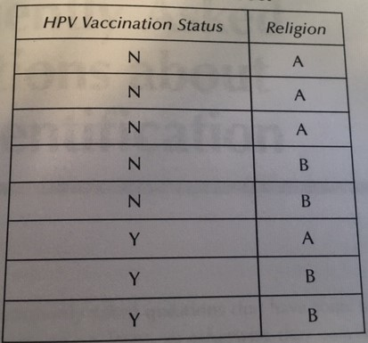
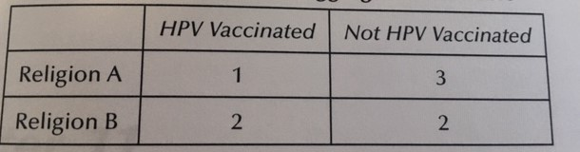
Example of Aggregate Data Table

Slide 11
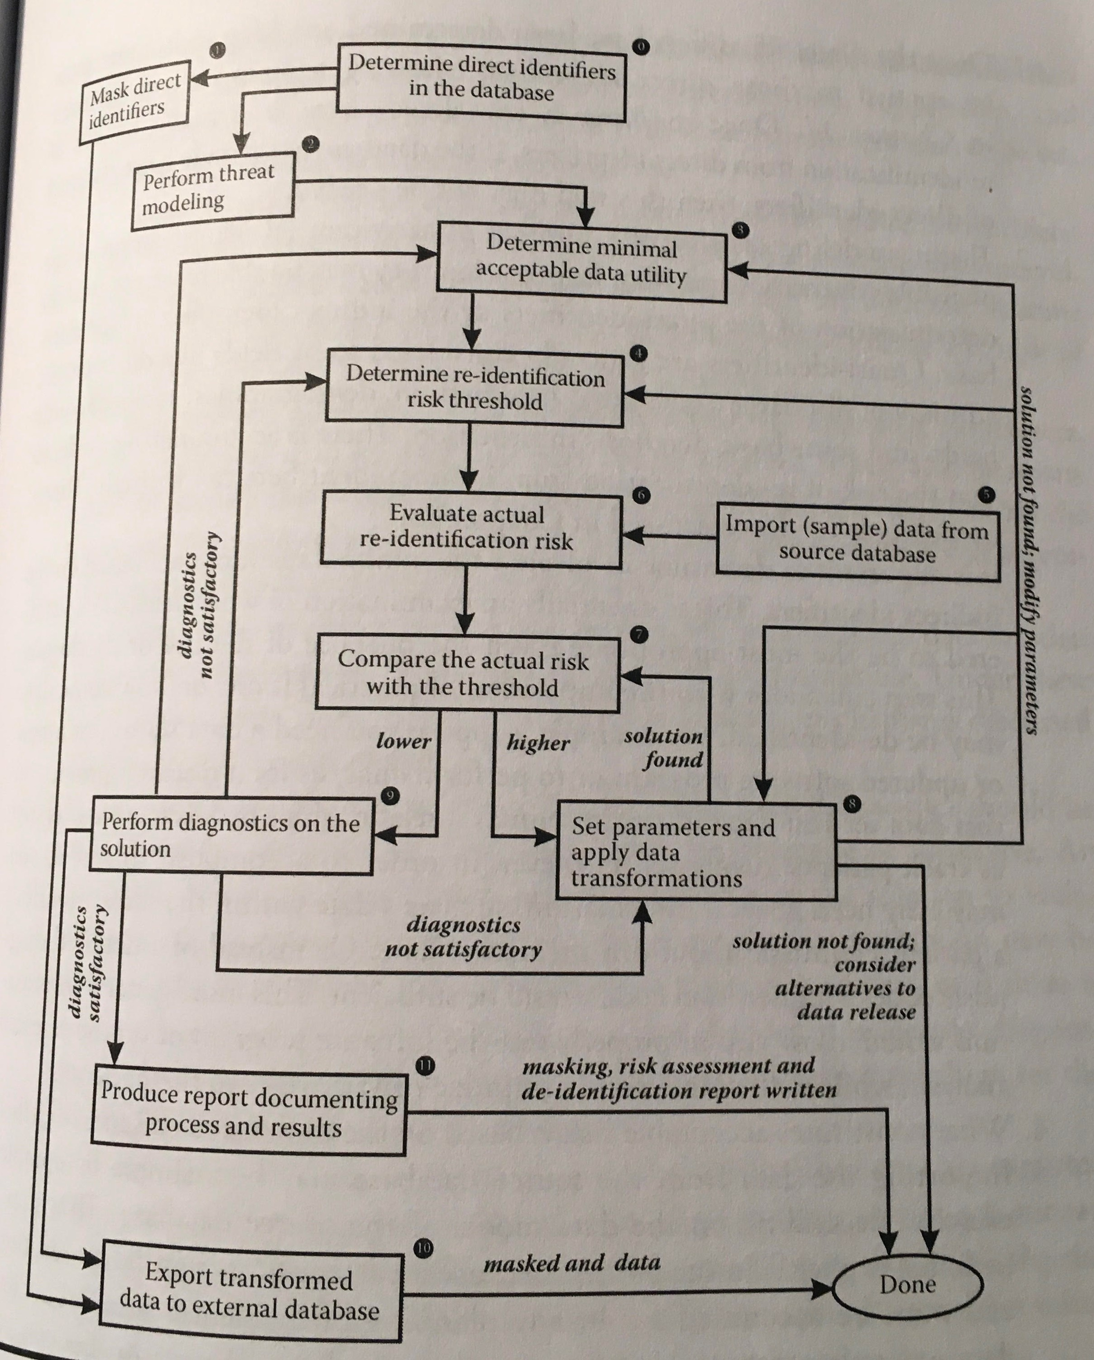
Managing Re-Identification Risk

Slide 12
Questions?

